Slide 1
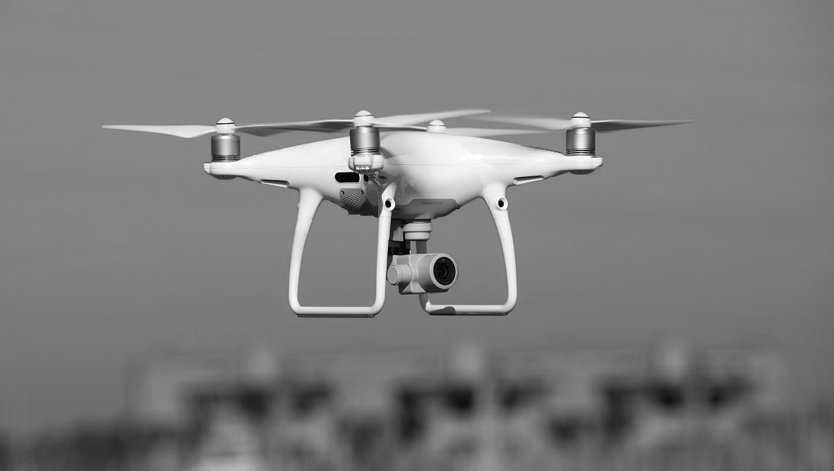
Nordic Drone Survey
A survey conducted in the Nordic countries for UAS Norway
Opinion // September 2023

Slide 2
Project information
CLIENT
METHODOLOGY
UAS Norway
Quantitative methodology, web based interview.
Anders Martinsen
OJECTIVE
TARGET GROUP
To provide an estaimated number of drones in the Nordic countries
M/F 18 years +, Norway, Sweden, Denmark, Finland.
TIMING
SAMPLE
The survey was conducted primo Semptember 2023.
Sample size approx 1000 nat rep for each country, sample weighted for age, gender and geography

Slide 3
Overall positive attitudes towards drones
Q1
Swedish population tend to be slightly more positive towards drones in general – 7 in 10 (71 percent) are strongly or somewhat positive towards drones in general
Sweden: 71 %
Norway: 65 %
Denmark: 61 %
Finland: 57 %
Males in all of the four countries tend to be more positive than females
Very few say they are negative, however 1 in 10 Norwegians say this making them slightly more sceptical than people in the other Nordic Countries
What is your general attitude towards drones?

Slide 4
There are more than 2 million drones in the Nordic countries
Q2 + Q3_a
The graph shows the estimated number of currently owned drones (blue) and planned purchases of drones (red)
No time limit were set for the planned purchase question
Ownership by share of the population 18+ evenly distributed across the four countries, se next page for percentages
Owners of drones dominated by males (mainly under 50 years), but 3-4 percent of females claim they own a drone
Do you currently own one or more drones? Are you planning to buy a drone?
*) Norwegian figures gathered in nat rep survey January 2024

Slide 5
Planned use of purchased drones
Q2 + Q3_a
Base: Plan to buy drone
The table shows intended usage by those planning to buy drones
Hobby puposes most significant in Finland

Slide 6
High awareness of registration obligation among drone owners – few have registered
Q3_b
Base: Own one/more drone(s)
Between 20-30 percent of drone owners are unaware that drones should be registered, most significant in Denmark
Many are aware of this, but has neglected the registration
Norway: 58 %
Sweden: 54 %
Finland: 50 %
Denmark 37 %
While many claim they have registered their drones in 2021, many may not be aware of the need for an annual renewal in example Norway
Awareness of registration obligation
var.

Slide 7
OLA GAUTE A. ASKHEIM
Rolle: Prosjektansvarlig
Ola Gaute har utdannelse fra Forsvaret, og mer enn 30 års erfaring fra analysebransjen, hvor han særlig har arbeidet med forbrukeradferd, merkevarer og utvikling av konsepter for ulike bransjer.
Han foreleser i vitenskapelig metode, har skrevet lærebok i emnet 'kvalitative metoder' og er en etterspurt foredragsholder.
Kontakt:
Ola Gaute A. Askheim
olag@opinion.no
(+47) 922 34 056

